Slide 1
Modeling phonological variation
Kie Zuraw, UCLA
EILIN, UNICAMP, 2013

Slide 2
Welcome!
How I say my name: [k^{h}ai]
Can you ask questions or make comments in Portuguese or Spanish?
  Sim!
  ¡Si!
Will my replies be grammatical and error-free?
  Não!
  ¡No!

Slide 3
Welcome!
How many of you took Michael Becker’s phonology course at the previous EVELIN?
How many of you are phonologists?
How many use regression models (statistics)?
How many use (or studied) Optimality Theory?
How many speak Portuguese?
How many speak Spanish?

Slide 4
Course outline
Day 1 (segunda-feira=today)
  Pre-theoretical models: linear regression
Day 2 (terça-feira)
  Grammar models I: noisy harmonic grammar
Day 3 (quarta-feira)
  Grammar models II: logistic regression and maximum entropy grammar
Day 4 (quinta-feira)
  Optimality Theory (OT): strict ranking; basic variation in OT
Day 5 (sexta-feira)
  Grammar models III: stochastic OT; plus lexical variation

Slide 5
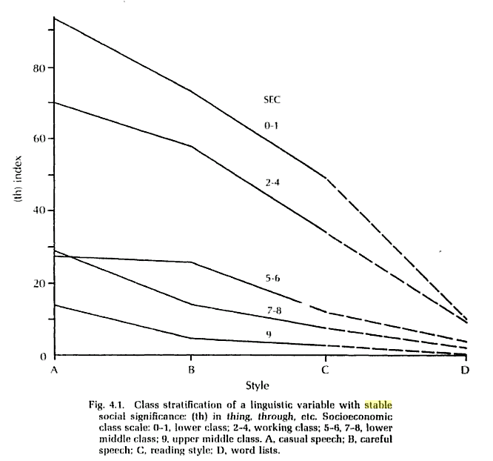
A classic sociolinguistic finding
Lots of [t̪]
New York City English, variation in words like three
Within each social group, more [θ] as style becomes more formal
Each utterance of /θ/ scored as 0 for [θ], 100 for [t̪θ], and 200 for [t̪]
Each speaker gets an overall average score.
Always [θ]
Labov 1972 p. 113

Slide 6
This is token variation
Each word with /θ/ can vary
  think: [θɪŋk] ~ [t̪θɪŋk] ~ [t̪ɪŋk]
  Cathy: [kæθi] ~ [kæt̪θi] ~ [kæt̪i]
  etc.
The variation can be conditioned by various factors
  style (what Labov looks at here)
  word frequency
  part of speech
  location of stress in word
  preceding or following sound
  etc.

Slide 7
Contrast with type variation
Each word has a stable behavior
  mão + s → mãos (same for irmão, grão, etc.)
  pão + s → pães (same for cão, capitão, etc.)
  avião + s → aviões (same for ambicão, posicão, etc.)
  (Becker, Clemens & Nevins 2011)
So it’s the lexicon overall that shows variation

Slide 8
Token vs. type variation
Type variation is easier to get data on
  e.g., dictionary data
Token variation is easier to model, though
In this course we’ll focus on token variation
  All of the models we’ll see for token variation can be combined with a theory of type variation

Slide 9
Back to Labov’s (th)-index
How can we model each social group’s rate of /θ/ “strengthening”,
  as a function of speaking style?
  (There are surely other important factors, but for simplicity we’ll consider only style)

Slide 10
Labov’s early approach
/θ/ → [–continuant] , optional rule
Labov makes a model of the whole speech community
  but let’s be more conservative and suppose that each group can have a different grammar.
Each group’s grammar has its own numbers a and b such that:
  (th)-index = a + b*Style
  where Style A=0, B=1, C=2, D=3

Slide 11
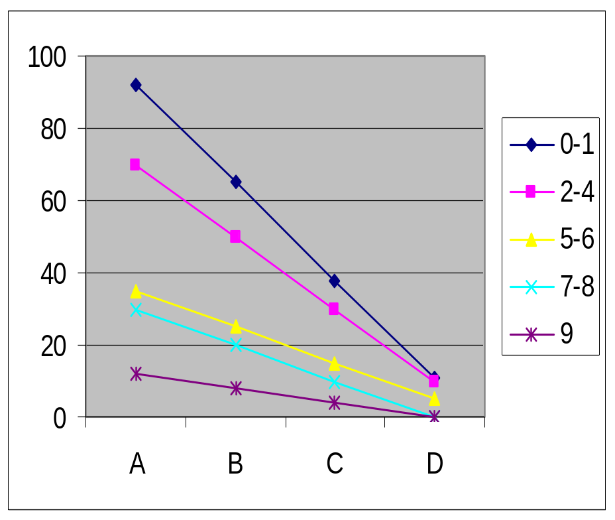
What does this model look like?
Real data
Model

Slide 12
This is “linear regression”
A widespread technique in statistics
  Predict one number as a linear function of another
  Remember the formula for a line: y = a + bx
  Or, for a line in more dimensions: y = a + bx₁ + cx₂ + dx₃
The number we are trying to predict, (th)-index, is the dependent variable (y)
The number we use to make the prediction, style, is the independent variable (x)
The numbers a, b, c, etc. are the coefficients
We could have many more independent variables:
  (th)-index = a + b * style + c * position_in_word + d * ...

Slide 13
Warning
It’s not quite correct to apply linear regression to this case
  The (th) index is roughly the rate of changing /θ/ ( x2)
    the numbers can only range from 0 to 200
  Model doesn’t know that the dependent variable is a rate
    It could, in theory, predict negative values, or values above 200
  On Day 3 we’ll see “logistic regression”, designed for rates, which is what sociolinguists also soon moved to
But, linear regression is easy to understand and will allow us to discuss some important concepts

Slide 14
So what is a model good for?
Allows us to address questions like:
  Does style really play a systematic role in the New York City th data?
  Does style work the same within each social group?
As our models become more grounded in linguistic theory...
  we can use them to explicitly compare different theories/ideas about learners and speakers

Slide 15
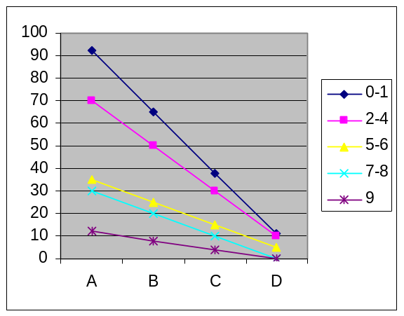
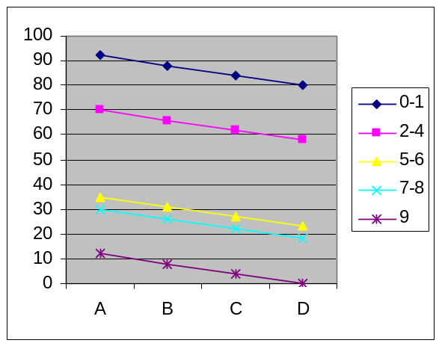
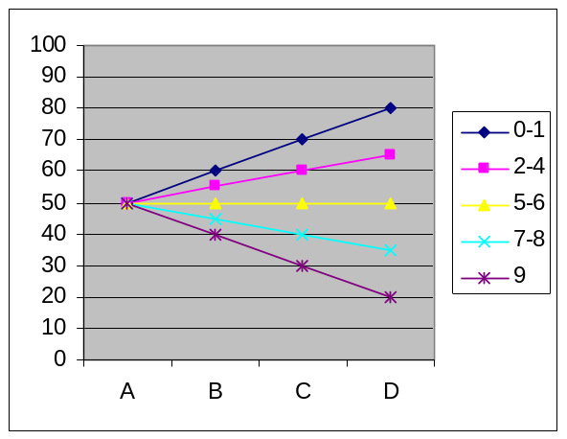
Some values of coefficients a and b are a closer “fit” to reality:

Slide 16
Measuring the fit/error
Fit and error are “two sides of the same coin”
  (= different ways of thinking about the same concept)
Fit: how close is the model to reality?
Error: how far is the model from reality?
  also known as “loss” or “cost”, especially in economics

Slide 17
Measuring the fit/error
You can imagine various options for measuring
But the most standard is:
  for each data point, take the difference between real (observed) value and predicted value
    square it
  sum all of these squares
  Choose coefficients (a and b) to make this sum as small as possible

Slide 18
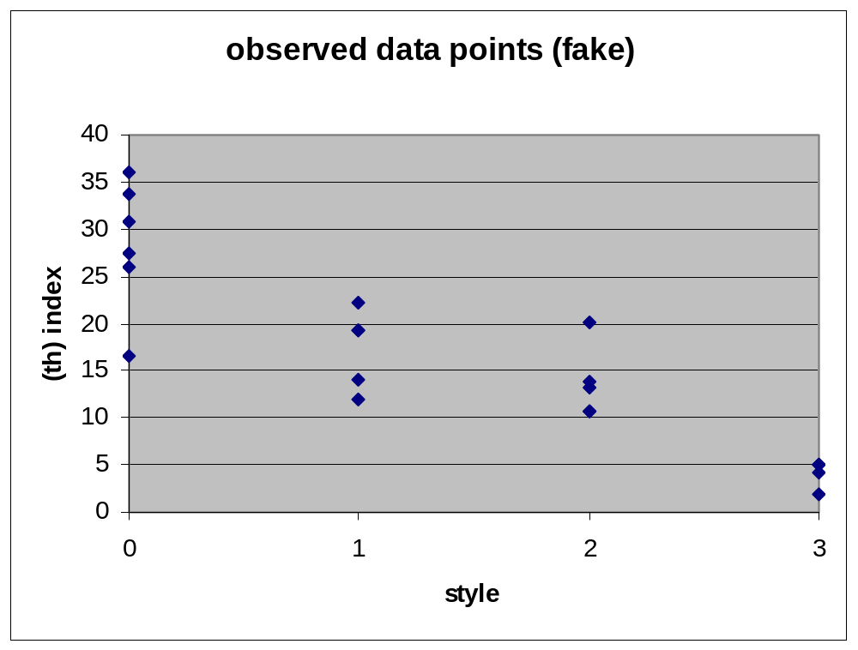
Example
I don’t have real (th)-index data for Labov’s speakers, but here are fake ones:
This observed point is 12, but model predicts 20.
Error is -8
Squared error is 64

Slide 19
Making the model fit better
Real data
Model
Instead of fitting straight lines as above, we could capture the real data better with something more complex:
  (th) index = a + b*Style + c*Style²

Slide 20
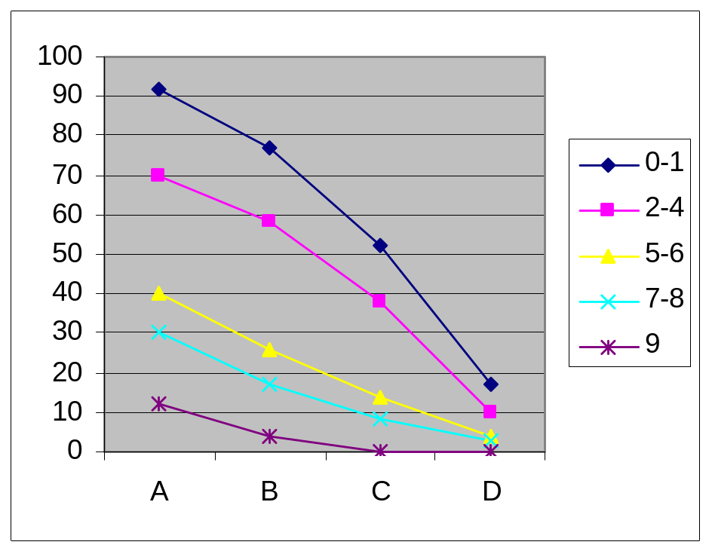
Making the model fit better
(th) index = a + b*Style + c*Style²
This looks closer.
But are these models too complex?
Are we trying to fit details that are just accidental in the real data?

Slide 21
Underfitting vs. overfitting
Underfitting: the model is too coarse/rough
  if we use it to predict future data, it will perform poorly
  E.g., (th)-index = 80
  Predicts no differences between styles, which is wrong
Overfitting: the model is fitting irrelevant details
  if we use it to predict future data, it will also perform poorly
  E.g., middle group’s lack of difference between A and B
  If Labov gathered more data, this probably wouldn’t be repeated
  A model that tries to capture it is overfitted

Slide 22
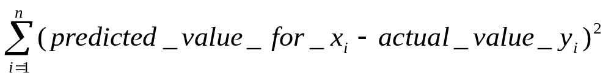
“Regularization”
A way to reduce overfitting
In simple regression, you ask the computer to find the coefficients that minimize the sum of squared errors:

Slide 23
Regularization
In regularized regression, you ask the computer to minimize the sum of square errors, plus a penalty for large coefficients
For each coefficient, square it and multiply by lambda. Add these up.
The researcher has to choose the best value of lambda
What happens if lambda is smaller? Bigger?

Slide 24
Regularization
In regularized regression, you ask the computer to minimize the sum of square errors, plus a penalty for large coefficients
Regularization is also known as smoothing.

Slide 25
Cases that linear regression is best for
When the dependent variable—the observations we are trying to model—is truly a continuous number:
  pitch (frequency in Hertz)
  duration (in milliseconds)
  sometimes, rating that subjects in an experiment give to words/forms you ask them about

Slide 26
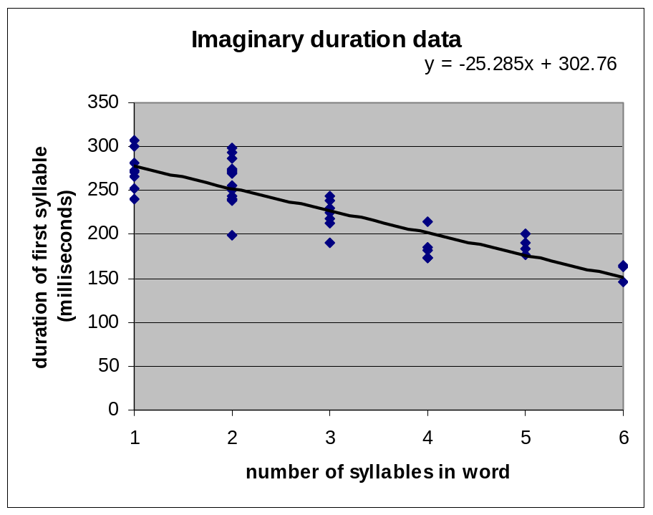
How to do it with software
Excel: For simple linear regression, with just one independent variable
  make a scatterplot
  “add trendline to chart”
  “show equation”

Slide 27
How to do it with software
Statistics software
  I like to use R (free from www.r-project.org/), but it takes effort to learn it
    Look for a free online course, e.g. from coursera.org
  Any statistics software can do linear regression, though: Stata, SPSS, ...

Slide 28
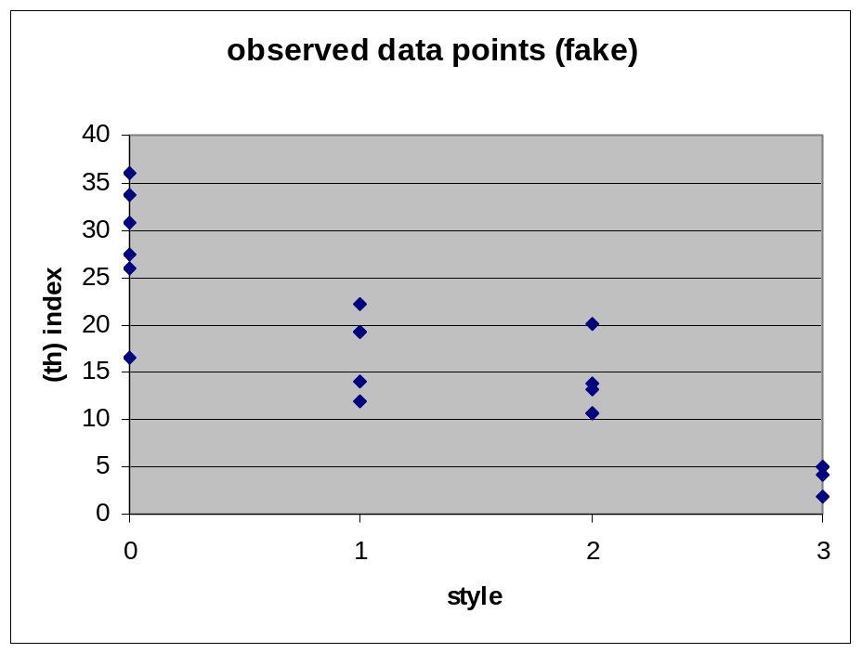
One more thing about regression: p-values
To demonstrate this, let’s use the same fake data for Group 5-6:

Slide 29
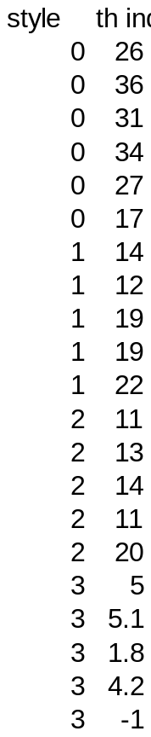
I gave the (fake) data to R:

Slide 30
R produces this output
Estimate Std. Error t value Pr(>|t|)
(Intercept) 27.6700 1.7073 16.206 1.40e-12 ***
style -8.0207 0.9352 -8.577 5.87e-08 ***
This part means (th)-index = 27.6700 - 8.0207*style
The “Standard error” is a function of the number of observations (amount of data), variance of data, and the errors—smaller is better
t-value is achieved by dividing coefficient by standard error—further from zero is better
Let’s see what the final column is...

Slide 31
P-values
Estimate Std. Error t value Pr(>|t|)
(Intercept) 27.6700 1.7073 16.206 1.40e-12 ***
style -8.0207 0.9352 -8.577 5.87e-08 ***
The last column asks “How surprising is the t-value”?
If the “true” value of the coefficient was 0, how often would we see such a large t-value just by chance?
  This is found by looking up t in a table
  One in a hundred times? Then p=0.01.
    Most researchers consider this sufficiently surprising to be significant.
    0.05 is a popular cut-off too, but higher than that is rare

Slide 32
P-values
Estimate Std. Error t value Pr(>|t|)
(Intercept) 27.6700 1.7073 16.206 1.40e-12 ***
style -8.0207 0.9352 -8.577 5.87e-08 ***
In this case, for intercept (a)
  p = 1.40 * 10⁻¹² = 0.0000000000014.
  So we can reject the hypothesis that the intercept is really 0.
  But this is not that interesting—it just tells us that in Style A, there is some amount of th-strengthening

Slide 33
P-values
Estimate Std. Error t value Pr(>|t|)
(Intercept) 27.6700 1.7073 16.206 1.40e-12 ***
style -8.0207 0.9352 -8.577 5.87e-08 ***
For style coefficient (b)
  p = 5.87 * 10⁻⁸ = 0.0000000587.
  So we can reject the hypothesis that the true coefficient is 0.
  In other words, we can reject the null hypothesis of no style effect
  We can also say that style makes a significant contribution to the model.

Slide 34
P-values
Estimate Std. Error t value Pr(>|t|)
(Intercept) 27.6700 1.7073 16.206 1.40e-12 ***
style -8.0207 0.9352 -8.577 5.87e-08 ***
Why is it called a p-value?
  p stands for “probability”
  What is the probability of just by chance fitting a style coefficient of -8.02 or more extreme, if style really made no difference.

Slide 35
P-values
Estimate Std. Error t value Pr(>|t|)
(Intercept) 27.6700 1.7073 16.206 1.40e-12 ***
style -8.0207 0.9352 -8.577 5.87e-08 ***
What are the ***s?
  R prints codes beside the p-values so you can easily see what is significant
  *** means p < 0.0001
  ** means p < 0.001
  * means p < 0.05
  . means p < 0.1

Slide 36
Summary of today
Linear regression
  A simple way to model how observed variation (dependent variable) depends on other factors (independent variables)
Underfitting vs. overfitting
  Both are bad—will make poor predictions about future data
  Regularization—a penalty for big coefficients—helps avoid overfitting

Slide 37
Summary of today, continued
Software
  finds coefficients automatically
Significance
  We can ask whether some part of the model is doing real “work” in explaining the data
    This allows us to test our theories: e.g., is speech really sensitive to style?

Slide 38
What else do you need to know?
To do linear regression for a journal publication, you probably need to know:
  if you have multiple independent variables, how to include interactions between variables
  how to standardize your variables
  if you have data from different speakers or experimental participants, how to use random effects
  the likelihood ratio test for comparing regression models with and without some independent variable
You can learn these from most statistics textbooks.
Or look for free online classes in statistics (again, coursera.org is a good source)

Slide 39
What’s next?
As mentioned, linear regression isn't suitable for much of the variation we see in phonology
  We’re usually interested in the rate of some variant occurring
  How often does /s/ delete in Spanish, depending on the preceding and following sound?
  How often does coda /r/ delete in Portuguese, depending on the following sound and the stress pattern?
  How often do unstressed /e,o/ reduce to [i,u] in Portuguese, depending on location of stress, whether syllable is open or closed ...

Slide 40
What’s next?
Tomorrow: capturing phonological variation in an actual grammar
  First theory: “Noisy Harmonic Grammar”
Day 3: tying together regression and grammar
  logistic regression: a type of regression suitable for rates
  Maximum Entropy grammars: similar in spirit to Noisy HG, but the math works like logistic regression
Day 4: Introduction to Optimality Theory, variation in Optimality Theory
Day 5: Stochastic Optimality Theory

Slide 41
One last thing: Goals of the course
Linguistics skills
  Optimality Theory and related constraint theories
  Tools to model variation in your own data
Important concepts from outside linguistics
  Today
    linear regression
    underfitting and overfitting
    smoothing/regularization
    significance
  Later
    logistic regression
    probability distribution
Unfortunately we don’t have time to see a lot of different case studies (maybe just 1 per day) or get deeply into the data, because our focus is on modeling

Slide 42
Very small homework
Please give me a piece of paper with this information
  Your name
  Your university
  Your e-mail address
  Your research interests (what areas, what languages—a sentence or two is fine, but if you want to tell me more that’s great)
You can give it to me now, later today if you see me, or tomorrow in class

Slide 43
Até amanhã!
¡Hasta mañana!

Slide 44
Day 1 references
Becker, Michael, Lauren Eby Clemens & Andrew Nevins. 2011. A richer model is not always more accurate: the case of French and Portuguese plurals. Manuscript. Indiana University, Harvard University, and University College London, ms.
Labov, William. 1972. The reflection of social processes in linguistic structures. Sociolinguistic Patterns, 110–121. Philadelphia: University of Pennsylvania Press.

Slide 45
Day 2: Noisy Harmonic Grammar
Today we’ll see a class of quantitative model that connects more to linguistic theory
Outline
  constraints in phonology
  Harmonic Grammar as way for constraints to interact
  Noisy Harmonic Grammar for variation

Slide 46
Phonological constraints
Since Kisseberth’s 1970 article “On the functional unity of phonological rules”, phonologists have wanted to include constraints in their grammars
The Obligatory Contour Principle (Leben 1973)
  Identical adjacent tones are prohibited: *bádó, *gèbù
  Later, extended to other features: [labial](V)[labial]

Slide 47
Phonological constraints
Constraints on consonant/vowel sequences in Kisseberth’s analysis of Yawelmani Yokuts
  *CCC: no three consonants in a row (*aktmo)
  *VV: *baup
  These could be reinterpreted in terms of syllable structure
    syllables should have onsets
    syllables should not have “complex” onsets or codas (more than one consonant)

Slide 48
Phonological constraints
But how do constraints interact with rules?
Should an underlying form like /aktmo/ (violates *CCC) be repaired by...
  deleting a consonant? (which one? how many?)
  inserting a vowel? (where? how many?)
  doing nothing? That is, tolerate the violation

Slide 49
Phonological constraints
Can *CCC prevent vowel deletion from applying to [usimta] (*usmta)?
  How far ahead in the derivation should rules look in order to see if they’ll create a problem later on?
  Can stress move from [usípta] to [usiptá], if there’s a rule that deletes unstressed [i] between voiceless consonants? (*uspta)
Deep unclarity on these points led to Optimality Theory (Prince & Smolensky 1993)

Slide 50
Optimality Theory basics
Procedure for a phonological derivation
  generate a set of “candidate” surface forms by applying all combinations of rules (including no rules)
    /aktmo/ → {[aktmo], [akitmo], [aktimo], [akitimo], [atmo], [akmo], [aktom], [bakto], [sifglu], [bababababa], ...}
  choose the candidate that best satisfies the constraints

Slide 51
Optimality Theory
Big idea #1: the role of rules becomes trivial
  Every language generates the same sets of surface forms
  Even the set of surface forms is the same for every underlying form!
    Both /aktmo/ and /paduka/ have the candidate [elefante]
    It just requires a different sequence of operations to get to [elefante] from each starting point

Slide 52
Optimality Theory
Big idea #2: constraints conflict and compete against each other
  All the action in the theory is in deciding how those conflicts should be resolved
  E.g. [uko] violates “syllables should have onsets”,
  but [ko] violates “words should be at least two syllables”

Slide 53
Big idea #3: Markedness vs. faithfulness
If it’s entirely up to the constraints to pick the best candidate, wouldn’t the winner always be the least marked form, whatever that is?
  [baba], [ʔəʔə] or something
Therefore, we need two kinds of constraint:
  markedness constraints: regulate surface forms (all the constraints we’ve seen so far are markedness constraints)
  but also faithfulness constraints: regulate relationship between underlying and surface forms.
    “Don’t delete consonants”
    “Don’t insert consonants”

Slide 54
Back to big idea #2: Constraint conflict
What happens when two constraints conflict?
  /aktmo/: to satisfy *CCC, either “don’t insert a vowel” or “don’t delete a consonant” has to be violated
We’ll see how it works in Classic OT in 2 days
For today, let’s see how it works in one version of the theory, Harmonic Grammar

Slide 55
Constraint conflict in Harmonic Grammar
First, let’s illustrate the conflict in a tableau
Constraints
The *s count violations
underlying form—also called “input”
/aktmo/ | *CCC | Don’tDelete | Don’tInsert | *VV
[aktmo] | *
[akitmo] |  |  | *
[aktimo] |  |  | *
[akmo] |  | *
selection of candidate surface forms—also called “output candidates”

Slide 56
How to choose the winning candidate
The language’s grammar includes a weight for each constraint
  These differ from language to language, even though they may have all the same constraints
/aktmo/ | *CCC weight = 5 | Don’tDelete w = 4 | Don’tInsert w = 3 | *VV w = 4 | har- mony
[aktmo] | * |  |  |  | -5
[akitmo] |  |  | * |  | -3
[aktimo] |  |  | * |  | -3
[akmo] |  | * |  |  | -4

Slide 57
How to choose the winning candidate
Each candidate is scored on its weighted constraint violations
  Each * counts as -1
  This score is sometimes called the harmony
/aktmo/ | *CCC weight = 5 | Don’tDelete w = 4 | Don’tInsert w = 3 | *VV w = 4 | har- mony
[aktmo] | * |  |  |  | -5
[akitmo] |  |  | * |  | -3
[aktimo] |  |  | * |  | -3
[akmo] |  | * |  |  | -4

Slide 58
How to choose the winning candidate
Harmony closer to zero is better
  So the winner is a tie between [akitmo] and [aktimo]
  If there are no other relevant constraints, we expect variation between these two candidates
/aktmo/ | *CCC weight= 5 | Don’tDelete w = 4 | Don’tInsert w = 3 | *VV w= 4 | har- mony
[aktmo] | * |  |  |  | -5
[akitmo] |  |  | * |  | -3
[aktimo] |  |  | * |  | -3
[akmo] |  | * |  |  | -4

Slide 59
Let’s do another example
In Spanish, /s/ in coda (end of syllable) can change to [h] or delete in many dialects
  [estaɾ] ~ [ehtaɾ] ~ [etaɾ]
How often this happens seems to depend on a couple of factors

Slide 60
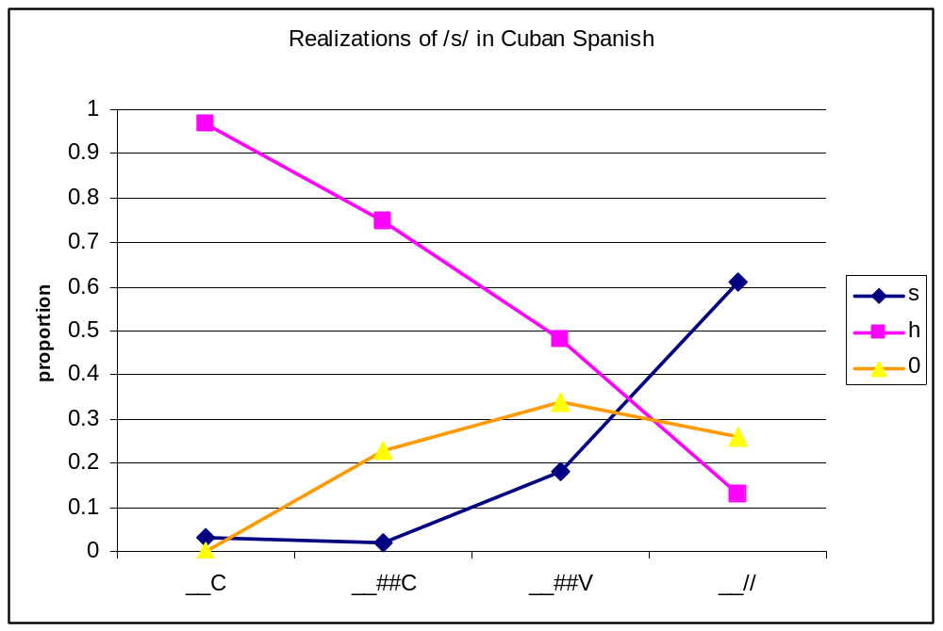
Spanish /s/-weakening, continued
Cuban Spanish: following sound has strong effect
  Bybee 2001, data from Terrell 1977; Terrell 1979; Bybee Hooper 1981

Slide 61
Grammar for (fragment of) Cuban Spanish
First, let’s pretend there is no variation—just take the most common outcome for each environment):
  [h] / __C (before consonant in same word: [ehtaɾ])
  [h] / __##C (before consonant in next word: [eh taɾðe]
  [h] / __##V (before vowel in next word: [eh amaßle]
  [s] / __ pause ([si, es]

Slide 62
Grammar for (fragment of) Cuban Spanish
Constraints (there are many other approaches I could have taken)
  *s: Don’t have [s]
    (we can assume that onset [s] is protected by a special faithfulness constraint, “don’t change onsets”)
  *h(##)C: don’t have [h] before C (in same word or next word)
  *h##: don’t have [h] at end of word
  *h//: don’t have [h] before pause
  Max-C: this is the “official” name for “Don’t delete consonant”
  Ident(sibilant): don’t change a sound’s value for the feature [sibiliant]
    Penalizes changing /s/ to [h]

Slide 63
Grammar for Cuban Spanish
The  means this candidate wins
/estaɾ/ | *s 4 | *h(##)C 1 | *h## 1 | *h// 3 | Max-C 5 | Id(sib) 1 | hrmny
[estaɾ] | * |  |  |  |  |  | -4
☞ [ehtaɾ] |  | * |  |  |  | * | -2
[etaɾ] |  |  |  |  | * |  | -5

Slide 64
Grammar for Cuban Spanish
The  means this candidate wins
/es taɾde/ | *s 4 | *h(##)C 1 | *h## 1 | *h// 3 | Max-C 5 | Id(sib) 1 | hrmny
[es taɾde] | * |  |  |  |  |  | -4
☞ [eh taɾde] |  | * | * |  |  | * | -3
[e taɾde] |  |  |  |  | * |  | -5

Slide 65
Grammar for Cuban Spanish
The  means this candidate wins
/es amable/ | *s 4 | *h(##)C 1 | *h## 1 | *h// 3 | Max-C 5 | Id(sib) 1 | h
[es amaßle] | * |  |  |  |  |  | -4
☞ [eh amaßle] |  |  | * |  |  | * | -2
[e amaßle] |  |  |  |  | * |  | -5

Slide 66
Grammar for Cuban Spanish
The  means this candidate wins
/si, es/ | *s 4 | *h(##)C 1 | *h## 1 | *h// 3 | Max-C 5 | Id(sib) 1 | h
☞ [si, es] | * |  |  |  |  |  | -4
[si, eh] |  |  | * | * |  | * | -5
[si, e] |  |  |  |  | * |  | -5

Slide 67
How can the weights be learned?
Scientific question
  If this is what humans really do, there must be a way for children to learn the weights for their language
Important practical question, too!
  If we want to use this theory to analyze languages, we need to know how to find the weights
Free Software: OT-Help (Staubs & al., http://people.umass.edu/othelp/ )
  The software has to solve a “system of linear inequalities”
Demonstration (switch to OT-Help)

Slide 68
How do we get variation?
We saw one special case of variation: the candidates have exactly the same constraint violations
  /aktmo/ → [akitmo] ~ [aktimo]
But this is unrealistic
  Surely there’s some constraint in the grammar that will break the tie
    “Closed syllables should be early”? “Closed syllables should be late”
    *kt vs. *tm
    etc.

Slide 69
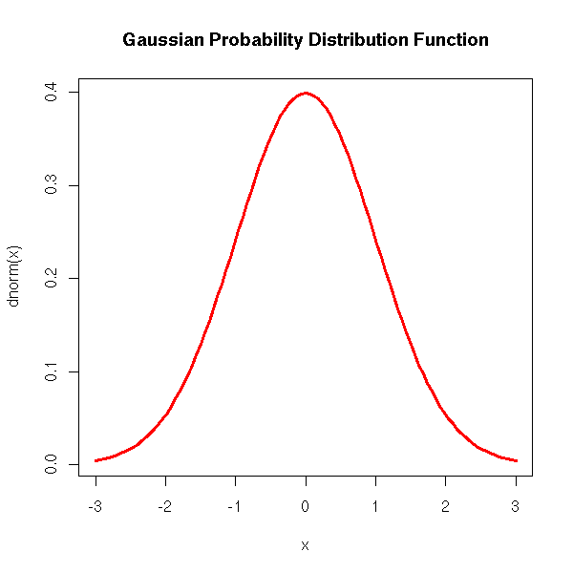
Instead, add noise to the weights
In every derivation (that is, every time the person speaks)...
...add some noise to each weight
  Generate a random number and add it to the weight
The random number is drawn from a “Gaussian” distribution
  also known as normal distribution or bell curve
  average value is 0; the farther from zero, the less probable
zoonek2.free.fr/UNIX/48_R/07.html

Slide 70
Example of adding noise to weights
With these particular noise values, winner is [si, eh]
/si, es/ | *s 4→ 4.5 | *h(##)C 1→ 0.7 | *h## 1→ 0.7 | *h// 3→ 2.8 | Max-C 5→ 4.7 | Id(sib) 1→ 0.7 | h
[si, es] | * |  |  |  |  |  | -4.5
☞ [si, eh] |  |  | * | * |  | * | -4.4
[si, e] |  |  |  |  | * |  | -4.7

Slide 71
What about non-varying phonology?
If the weights are very far apart, no realistic amount of noise can change the winner.
E.g., a language that allows a word to begin with 2 consonants
[stim] can lose, but very rarely will
/stim/ | *CC 1 → 1.3 | Max-C 10 → 9.4 | Dep-V =“don’t insert vowel” 10 → 8.8 | harmony
stim | * |  |  | -1.3
tim |  | * |  | -9.4
istim |  |  | * | -8.8

Slide 72
How are weights learned in Noisy HG?
This is a little harder—there’s no equation or system of equations to solve
Pater & Boersma (to appear) shows that the following algorithm (next slide) succeeds for nonvarying target languages

Slide 73
Gradual Learning Algorithm
Originally proposed by Boersma (1998) for a different theory that we’ll see on Friday.
Procedure:
  Start with all the weights at some set of values, say all -100
  When the learner hears a form from an adult...
    The learner uses its own noisy HG grammar to generate an output for that same input
    If the output matches what the adult said, do nothing
    If the output doesn’t match
      if a constraint prefers the learner’s wrong output, decrease weight
      if a constraint prefers the adult’s output, increase weight

Slide 74
Example
Adult says [aktmo]
Learner’s grammar says [akmo]
/aktmo/ | *CCC 100→ 100.2 | Max-C 100→ 99.9 | Dep-V 100→ 101.1 | har- mony
[aktmo] | * decrease! |  |  | -100.2
[akitmo] |  |  | * | -101.1
[aktimo] |  |  | * | -101.1
[akmo] |  | * increase! |  | -99.9

Slide 75
Example
Now 2 of the weights are different
The learner is now less likely to make that mistake
/aktmo/ | *CCC 99→ 99.5 | Max-C 101→ 100.9 | Dep-V 100→ 100.3 | har- mony
[aktmo] | * |  |  | -99.5
[akitmo] |  |  | * | -100.3
[aktimo] |  |  | * | -100.3
[akmo] |  | * |  | -100.9

Slide 76
“Plasticity”
= amount that ratings change
Software allows you to choose
But typically, starts at 2 and decreases towards 0.002
  Thus, grammar becomes stable even if learning data continues to vary

Slide 77
Results for Spanish example
I used a beta version of OTSoft for this (free software that we’ll discuss later in the week)
Can also be done in Praat (praat.org)
  17.800 Max-C
  17.742 *s
  10.458 Ident(sib)
  5.636 *h//
  5.020 *h##
  0.008 *h(##)C

Slide 78
How weights change over time
Unfortunately there’s currently no option in OTSoft for tracking the weights over time
But let’s watch them change on the screen in OTSoft (switch to OTSoft demo)

Slide 79
Variation and the Gradual Learning Algorithm
Suppose, as in our demo, that adults produce variation between [s] and [h]—will the learner ever stop making mistakes?
Will the weights ever stop changing?

Slide 80
Free software
OTSoft, www.linguistics.ucla.edu/people/hayes/otsoft
  Easy to use
  Noisy HG feature is in development—next version should have it
OT-help, people.umass.edu/othelp/
  Learns non-noisy HG weights
  Will even tell you all the possible languages, given those constraints and candidates (“factorial typology”)
  Easy to use—same input format as OTSoft, has a good manual
Praat, www.praat.org
  Learns noisy HG weights
  Not so easy to use, though

Slide 81
Key references in Harmonic Grammar
Legendre, Miyata, & Smolensky 1990: original proposal
Smolensky & Legendre 2006: a book-length treatment
Pater & Boersma 2008: noisy HG (for non-varying data)
Pater, Jesney & Tessier 2007; Coetzee & Pater 2007: noisy HG for variation

Slide 82
Summary of today
Grammars that do away with rules (or trivialize them) and give all the work to conflicting constraints
  One particular version, Harmonic Grammar
  Variation: Noisy Harmonic Grammar
  The Gradual Learning Algorithm for learning Noisy HG weights

Slide 83
Coming up
Tomorrow: Unifying Harmonic Grammar with regression
  Logistic regression, Maximum Entropy grammars
Day 4: A different way for constraints to interact
  Classic Optimality Theory’s “strict domination”
Day 5: Variation in Classic OT
  the Gradual Learning Algorithm will be back)

Slide 84
Até amanhã!

Slide 85
Day 2 references
Boersma, P. (1998). Functional Phonology: Formalizing the Interaction Between Articulatory and Perceptual Drives. The Hague: Holland Academic Graphics.
Boersma, P., & Pater, J. (2008). Convergence properties of a Gradual Learning Algorithm for Harmonic Grammar. manuscript, University of Amsterdam and University of Massachusetts, Amherst.
Coetzee, A., & Pater, J. (2007). Weighted constraints and gradient phonotactics in Muna and Arabic.
Kisseberth, C. (1970). On the functional unity of phonological rules. Linguistic Inquiry, 1, 291–306.
Leben, W. (1973). Suprasegmental Phonology. MIT.
Legendre, G., Miyata, Y., & Smolensky, P. (1990). Harmonic Grammar – A formal multi-level connectionist theory of linguistic well-formedness: An Application. In Proceedings of the Twelfth Annual Conference of the Cognitive Science Society (pp. 884–891). Mahwah, NJ: Lawrence Erlbaum Associates.
Pater, J., Jesney, K., & Tessier, A.-M. (2007). Phonological acquisition as weighted constraint interaction. In A. Belikova, L. Meroni, & M. Umeda (Eds.), Proceedings of the 2nd Conference on Generative Approaches to Language Acquisition in North America (GALANA) (pp. 339–350). Somerville, MA: Cascadilla Proceedings Project.
Prince, A., & Smolensky, P. (2004). Optimality Theory: Constraint interaction in generative grammar. Malden, Mass., and Oxford, UK: Blackwell.
Smolensky, P., & Legendre, G. (2006). The Harmonic Mind: From Neural Computation to Optimality-Theoretic Grammar. Cambridge, MA: MIT Press.

Slide 86
Day 3: Before we start
A good explanation of the Gradual Learning Algorithm (learner promotes and demotes constraints when it makes an error):
  Paul Boersma & Bruce Hayes 2001, “Empirical tests of the Gradual Learning Algorithm” (easy to find online)
  Learning is in Strict-Ranking Optimality Theory rather than Noisy Harmonic Grammar, though

Slide 87
Day 3: Logistic regression and MaxEnt
Logistic regression: regression models for rates
Maximum Entropy constraint grammars: similar to Harmonic Grammar
  but better understood mathematically
Logistic regression and MaxEnt are actually the same!

Slide 88
Example: English /θ/ strengthening again
Dependent variable: rate of strengthening (th-index divided by 2)
Independent variable: style
  from 0 (most informal) to 4 (most formal)
Regression model
  rate = 13.8 – 4.0 * style

Slide 89
What’s wrong with linear regression for rates: problem #1
Rates range from 0 to 100
  but linear regression doesn’t know that—it can predict rates outside that range
E.g. rate = 13.8 – 4.0 * style
  in style 0, rate is 13.8
  in style 1, rate is 9.8
  in style 2, rate is 5.8
  in style 3, rate is 1.8
  so if there were a style 4, rate would be... -2.2??

Slide 90
What’s wrong with linear regression for rates: problem #2
Linear regression assumes that the variance is similar across the range of the independent variable
  E.g, th-strengthening rates vary about the same amount in style 0 as in style 3
  But that’s not true: in style 3, everyone’s rate is close to 0, so there’s less variation
If this assumption isn’t met, the coefficients aren’t guaranteed to be the “best linear unbiased estimators”

Slide 91
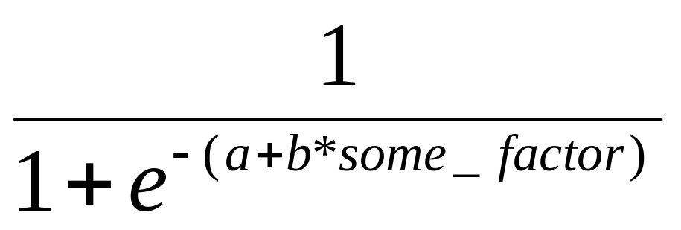
Solution: Logistic regression
Instead of modeling each person’s rate, we model each data point
  e.g. 0 if [θ]; 1 if [t̪] (as simplification, we ignore [t̪θ])
Instead of rate = a + b*some_factor
probability of 1 ([t̪]) =

Slide 92

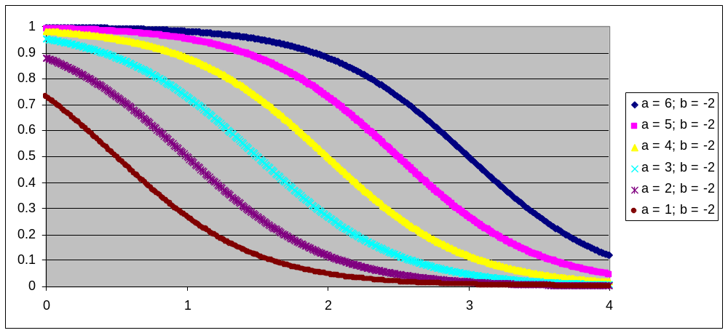
Sample curves for

Slide 93
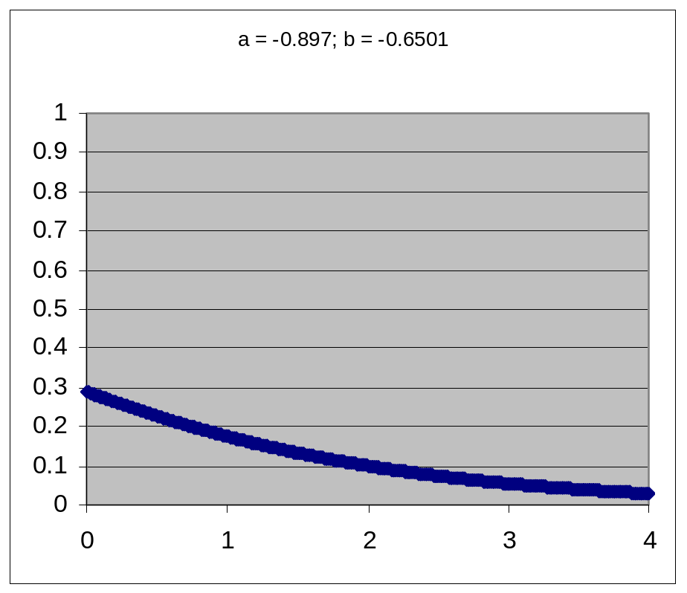
Fake data from social group 5-6
Logistic regression in R (demo)
Estimate Std. Error z value Pr(>|z|)
(Intercept) -0.8970 0.1981 -4.529 5.94e-06 ***
style -0.6501 0.1410 -4.609 4.04e-06 ***
Probability of th-strengthening
  = 1/(1+e^{-(-0.8970-0.6501*style)})

Slide 94
Compare to real data (social group 5-6)

Slide 95
A more complex case: Spanish s-weakening
Dependent variable: 0 (s), 1 (h or zero)
Independent variables:
  Is at end of word? 0 (no) or 1 (yes)
  Is at end of phrase? 0 (no) or 1 (yes)
  Is followed by vowel? 0 (no) or 1 (yes)

Slide 96
Spanish model
(show in r)
Estimate Std. Error z value Pr(>|z|)
(Intercept) -3.4761 0.5862 -5.930 3.03e-09 ***
word_final -0.4157 0.9240 -0.450 0.65277
phrase_final 4.3391 0.7431 5.839 5.24e-09 ***
followed_by_V 2.3755 0.7602 3.125 0.00178 **
Let’s write out the predicted probability for each case on the board (I’ll do the first one)

Slide 97
Note on sociolinguistics
Early on, sociolinguistics researchers adopted logistic regression, sometimes called Varbrul (variable rule) analysis.
Various researchers, especially David Sankoff, developed software called GoldVarb (Sankoff, Tagliamonte, & Smith 2012 for most recent version) for doing logistic regression in sociolinguistics.
Goldvarb uses slightly different terminology though.
If you’re reading sociolinguistics work in the Varbrul, see Johnson 2009 for a helpful explanation of how the terminology differs.

Slide 98
What if there are 3 or more outcomes possible?
We need multinomial logistic regression
For example, in R, you can use the multinom() function, in the nnet package (Venables & Ripley 2002)
We won’t cover this here!
The fundamentals are similar, though.

Slide 99
Connecting this to grammar: Maximum Entropy grammars
Just like Harmonic Grammar, except:
in HG, harmony is the weighted sum of constraint violations
  Candidate with best harmony wins
  We need to add noise to weights in order to get variation
In MaxEnt, we exponentiate the weighted sum: e^{weighted_sum}
  Each candidate’s probability of winning is proportional to that number

Slide 100
Noisy HG reminder
/aktmo/ | *CCC w= 5 | Max-C w = 4 | Dep-V w = 3 | NoisyHG harmony
[aktmo] | * |  |  | -5
[akitmo] |  |  | * | -3
[aktimo] |  |  | * | -3
[akmo] |  | * |  | -4

Slide 101
Maximum Entropy
/aktmo/ | *CCC w= 5 | Max-C w = 4 | Dep-V w = 3 | MaxEnt score | MaxEnt prob. of winning = harmony/sum
[aktmo] | * |  |  | e⁻⁵ | 0.05
[akitmo] |  |  | * | e⁻³ | 0.40
[aktimo] |  |  | * | e⁻³ | 0.40
[akmo] |  | * |  | e⁻⁴ | 0.15
 |  |  |  | sum = 0.125

Slide 102
Differences?
In MaxEnt, it’s a bit easier to see each candidate’s probability—we can calculate it directly
As we’ll see, the math is more solid for MaxEnt

Slide 103
MaxEnt for Spanish
Simpler constraint set, to match regression
Combine [h] and zero outcomes
/es amable/ | *s## | Max-C/ phrase-final | Max-C/__V | *s
[es amaßle] | * |  |  | *
[e amaßle] |  |  | *

Slide 104
Spanish results
(show learning in OTSoft)
Resulting weights
/es amable/ | *s## 0.42 | Max-C/ phrs-fnl 4.34 | Max-C/__V 2.38 | *s 3.48 | score | prob
[es amaßle] | * |  |  | * | e^{-3.90} | 0.18
[e amaßle] |  |  | * |  | e^{-2.38} | 0.82
 |  |  |  | sum:

Slide 105
Compare MaxEnt and regression
MaxEnt weights
  3.4761 *s
  0.4157 *s##
  4.3391 Max-C/phrase-final
  2.3755 Max-C/__V
Logistic regression coefficients
  (Intercept) -3.4761
  word_final -0.4157
  phrase_final 4.3391
  followed_by_V 2.3755

Slide 106
Why are the values the same?
I’ll use the blackboard to write out the probability of [e amable] vs. [es amable]

Slide 107
Is there any difference between MaxEnt and logistic regression?
Not really
  Statisticians call it logistic regression
  Machine-learning researchers call it Maximum Entropy classification
It’s easier to think about logistic regression in terms of properties of the underlying form
  e.g., “If /s/ changed to [h], would the result contain [h(##)C]?
It’s easier to think about MaxEnt in terms of properties of each surface candidate
  e.g., “Does it contain [h(##)C]?”
  “Did it change the feature [sibiliant]?
In MaxEnt you also don’t need to worry about what class each candidate falls into
  you can just list all the candidates you want and their constraint violations

Slide 108
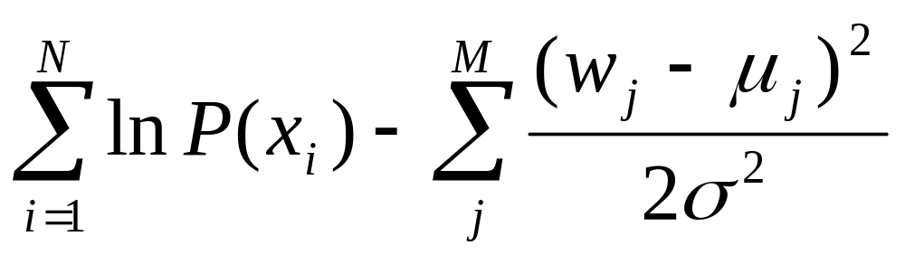
How do we (or the learner) find the weights?
We ask the computer to find the weights that maximize this expression:
”likelihood” of observed data (probability according to the model) – penalty on weights
  I’ll break this down on the board

Slide 109
How do we (or the learner) find the weights?
How the computer does it
  start from some list of weights (e.g., all 0)
  check nearby weights and see if they produce a better result
    actually, the computer can use matrix algebra to determine which way to go
  repeat until no more improvement (or improvement is less than some threshold amount)
Why this is guaranteed to work
  In MaxEnt the search space is “convex”: if you find weights better than all the nearby weights, it’s guaranteed that those are the best weights
  This is not necessarily true for all types of models

Slide 110
Back to the penalty on weights
Called a Gaussian prior
In the simple case (mu=0), this just prevents overfitting
  Keeps the weights small
  Where possible, spread the weight over multiple constraints rather than putting it all on one weight (see Martin 2011 for empirical evidence of this)

Slide 111
But we can also use the Gaussian prior to say that each constraint has a particular weight that it universally prefers (mu)
  Perhaps for phonetic reasons
  See White 2013 for empirical evidence
We can also give each constraint its own degree of willingness to change from default weight (sigma)
  See Wilson 2006 for empirical evidence

Slide 112
Software
Unfortunately, OTSoft doesn’t implement a prior.
We need to use different free software (but same input file format!), MaxEnt Grammar Tool (www.linguistics.ucla.edu/people/hayes/MaxentGrammarTool/)
(demo)

Slide 113
How do you choose the right prior?
In Machine Learning, this is treated as an empirical question:
  Using different priors, train a model on one subset of the data, then test it on a different subset.
  The prior that produces the best result on the testing data is the best one
For us, this should also be an empirical question:
  if MaxEnt is “true”—how humans learn—we should try to find out the mus and sigmas that human learners use

Slide 114
Choosing the right prior: White 2013
Develops a theory of μs (default weights) based on phonetic properties
  perceptual similarity between sounds
Tests the theory in experiments
  teaches part of an artificial language to adults
  tests how they perform on types of words they weren’t taught
Has no theory of σ (willingness to change from default weights)
  uses experimental data to find the best σ

Slide 115
One last example
Let’s use OTSoft to fit a MaxEnt grammar to Spanish with all three outcomes, and our original constraints

Slide 116
Summary of today
Logistic regression: a better way to model rates
Maximum Entropy constraint grammars: very similar to Harmonic Grammar
  But, easier to calculate each candidate’s probability
  Because it’s essentially logistic regression, the math is very well understood
    learning algorithm is guaranteed to work
    well-worked-out theory of smoothing: the Gaussian prior

Slide 117
Day 3 references
Boersma, P., & Hayes, B. (2001). Empirical tests of the gradual learning algorithm. Linguistic Inquiry, 32, 45–86.
Martin, A. (2011). Grammars leak: modeling how phonotactic generalizations interact within the grammar. Language, 87(4), 751–770.
Sankoff, D., Tagliamonte, S., & Smith, E. (2012). GoldVarb Lion: a multivariate analysis application. University of Toronto, University of Ottawa. Retrieved from http://individual.utoronto.ca/tagliamonte/goldvarb.htm
White, J. (2013). Learning bias in phonological alternations [working title] (PhD dissertation). UCLA.
Wilson, C. (2006). Learning Phonology with Substantive Bias: An Experimental and Computational Study of Velar Palatalization. Cognitive Science, 30(5), 945–982.

Slide 118
Até amanhã!
¡Hasta mañana!

Slide 119
Day 4 Classic OT
Although we’ve seen most of the ingredients of OT, there’s one more big thing you need to know to be able to read OT papers and listen to OT talks
Constraints interact through strict ranking instead of through weighting

Slide 120
Analogy: alphabetical order
Constraints
  HaveEarly1stLetter
  HaveEarly2ndLetter
  HaveEarly3rdLetter
  HaveEarly4thLetter
  HaveEarly5thLetter
  ...

Slide 121
Harmonic grammar
Cabana wins because it does much better on less-important constraints
 | 1st w=5 | 2nd w=4 | 3rd w=3 | 4th w=2 | 5th w=1 | harm.
banana | -1 |  | -13 |  | -13 | -57
azalea |  | -25 |  | -11 | -4 | -126
azote |  | -25 | -14 | -19 | -4 | -184
cabana | -2 |  | -1 |  | -13 | -26

Slide 122
Classic Optimality Theory
Strict ranking: all the candidates that aren’t the best on the top constraint are eliminated
  “!” means “eliminated here”
  Shading on rest of row indicates it doesn’t matter how well or poorly the candidate does on subsequent constraints
 | 1st | 2nd | 3rd | 4th | 5th
banana | 1! |  | 13 |  | 13
azalea |  | 25 |  | 11 | 4
azote |  | 25 | 14! | 19 | 4
cabana | 2! |  | 1 |  | 13

Slide 123
Classic Optimality Theory
Repeat the elimination for subsequent constraints
Here, the two remaining candidates tie (both are the best), so we move to the next constraint
Winner(s) = the candidates that remain
 | 1st | 2nd | 3rd | 4th | 5th
banana | 1! |  | 13 |  | 13
☞ azalea |  | 25 |  | 11 | 4
azote |  | 25 | 14! | 19 | 4
cabana | 2! |  | 1 |  | 13

Slide 124
Example tableaux: find the winner
 | Constraint1 | C2 | C3 | C4
a. | * |  |  | *
b. | * | *
c. | * |  | *

Slide 125
Example tableaux: find the winner
 | C1 | C2 | C3 | C4
a. | ** |  |  | *
b. | * | *
c. | * |  | *

Slide 126
Example tableaux: find the winner
 | C1 | C2 | C3 | C4
a. | *
b. |  | * |  | ***
c. |  | * | *

Slide 127
Example tableaux: find the winner
 | C1 | C2 | C3 | C4
a. |  | ** | *
b. |  | ** | * | *
c. |  | ***

Slide 128
“Harmonically bounded” candidates
A fancy term for candidates that can’t win under any ranking
Simple harmonic bounding: What can’t (c) win under any ranking?
 | C2 | C3 | C4
a. | * |  | *
b. | * | *
c. | ** | *

Slide 129
“Harmonically bounded” candidates
Joint harmonic bounding: What can’t (c) win under any ranking?
 | C1 | C2
a. | **
b. |  | **
c. | * | *

Slide 130
Why this matters for variation
“Multi-site” variation: more than one place in word that can vary
Which candidates can win under some ranking?
/akitamiso/ | *i | Max-V
a. [akitamiso] | **
b. [aktamiso] | * | *
c. [akitamso] | * | *
d. [aktamso] |  | **
/akitamiso/ | Max-V | *i
a. [akitamiso] |  | **
b. [aktamiso] | * | *
c. [akitamso] | * | *
d. [aktamso] | **

Slide 131
Why this matters for variation
Even if the ranking is allowed to vary, candidates like (b) and (c) can never occur
/akitamiso/ | *i | Max-V
a. [akitamiso] | **
b. [aktamiso] | * | *
c. [akitamso] | * | *
d. [aktamso] |  | **
/akitamiso/ | Max-V | *i
a. [akitamiso] |  | **
b. [aktamiso] | * | *
c. [akitamso] | * | *
d. [aktamso] | **

Slide 132
How about in MaxEnt?
Can (b) and (c) ever occur?
/akitamiso/ | *i | Max-V
a. [akitamiso] | **
b. [aktamiso] | * | *
c. [akitamso] | * | *
d. [aktamso] |  | **

Slide 133
How about in Noisy Harmonic Grammar?
Suppose the two constraints have the same weight
/akitamiso/ | *i w=1 | Max-V w=1
a. [akitamiso] | **
b. [aktamiso] | * | *
c. [akitamso] | * | *
d. [aktamso] |  | **

Slide 134
Special case in Noisy HG
/apataka/ | *aCa w=a | Ident(lo) w=b | harmony | wins (or ties) if
a. [apataka] | *** |  | -3a | a < ½ b
b. [epataka] | ** | * | -2a-b | --
c. [apetaka] | * | * | -a-b | a < b < 2a
d. [apateka] | * | * | -a-b | a < b < 2a
e. [apatake] | ** | * | -2a-b | --
f. [epateka] |  | ** | -2b | b < a
g. [epatake] | * | ** | -a-2b | --
d. [apetake] |  | ** | -2b | b < a

Slide 135
Summary for harmonic bounding
In OT, harmonically bounded candidates can never win under any ranking
  means that applying a change to one part of a word but not another is impossible
In MaxEnt, all candidates have some probability of winning.
In Noisy HG, harmonically bounded candidates can win only in special cases.
See Jesney 2007 for a nice discussion of harmonic bounding in weighted models.

Slide 136
Is it good or bad that (b) and (c) can’t win in OT?
/akitamiso/ | *i | Max-V
a. [akitamiso] | **
b. [aktamiso] | * | *
c. [akitamso] | * | *
d. [aktamso] |  | **
In my opinion, probably bad, because there are several cases where candidates like (b) and (c) do win...

Slide 137
French optional schwa deletion
There’s a long literature on this. See Riggle & Wilson 2005, Kaplan 2011 Kimper 2011 for references.
La queue de ce renard no deletion
La queue d’ ce renard some deletion
La queue de c’ renard some deletion
La queue de ce r’nard some deletion
La queue d’ ce r’nard as much deletion as possible, without violating *CCC

Slide 138
Pima plural marking
Munro & Riggle 2004, Uto-Aztecan language of Mexico, about 650 speakers [Lewis 2009].
Infixing reduplication marks plural.
In compounds, any combination of members can reduplicate, as long as at least one does:
  Singular: [ʔus-kàlit-váinom], lit. tree-car-knife ‘wagon-knife’
  Plural options:
  ʔuʔus-kàklit-vápainom ‘wagon-knives’
  ʔuʔus-kàklit-váinom
  ʔuʔus-kàlit-vápainom
  ʔus-kàklit-vápainom
  ʔuʔus-kàlit-váinom
  ʔus-kàklit-váinom
  ʔus-kàlit-vápainom

Slide 139
Simplest theory of variation in OT: Anttila’s partial ranking (Anttila 1997)
Some constraints’ rankings are fixed; others vary
I’m using the red line here to indicate varying ranking
 | /θɪk/ | Max-C | Ident(place) | *θ | Ident(cont) | *Dental
☞ a | [θɪk] |  |  | * |  | *
☞ b | [t̪ɪk] |  |  |  | * | *
c | [ɪk] | *!
d | [sɪk] |  | *!

Slide 140
Anttilan partial ranking
Max-C
Ident(place)
*θ Ident(continuant)
*Dental

Slide 141
Linearization
In order to generate a form, the constraints have to be put into a linear order
Each linear order consistent with the grammar’s partial order is equally probable
grammar linearization 1 (50%) lineariztn 2 (50%)
Max-C Max-C Max-C
Ident(place) Ident(place)
Id(place) *θ Ident(cont)
Ident(cont) *θ
*θ Id(cont) *Dental *Dental
*Dental  [t̪ɪk]  [θɪk]

Slide 142
Properties of this theory
No learning algorithm, unfortunately
Makes strong predictions about variation numbers:
  If there are 2 constraints, what are the possible Anttilan grammars?
  What variation pattern does each one predict?

Slide 143
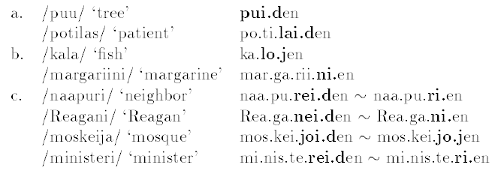
Finnish example (Anttila 1997)
The genitive suffix has two forms
  “strong”: -iden/-iten (with additional changes)
  “weak”: -(j)en (data from p. 3)

Slide 144
Factors affecting variation
Anttila shows that choice is governed by...
  avoiding sequence of heavies or lights (*HH, *LL)
  avoiding high vowels in heavy syllables (*H/I) or low vowels in light syllables (*L/A)

Slide 145
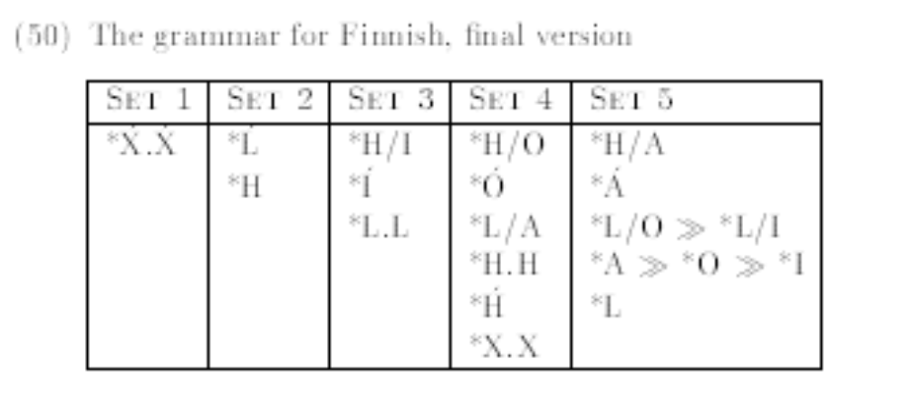
Anttila’s grammar (p. 21)
(Without going through the whole analysis)

Slide 146
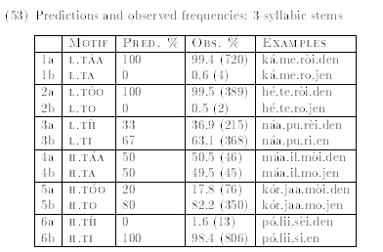
Sample of the results (p. 23)

Slide 147
Day 4 summary
We’ve seen Classic OT, and a simple way to capture variation in that theory
But there’s no learning algorithm available for this theory, so its usefulness is limited
Also, predictions may be too restrictive
  E.g. if there are 2 constraints, the candidates must be distributed 100%-0%, 50%-50%, or 0%-100%

Slide 148
Next time (our final day)
A theory of variation in OT that permits finer-grained predictions, and has a learning algorithm
Ways to deal with lexical variation

Slide 149
Day 4 references
Anttila, A. (1997). Deriving variation from grammar. In F. Hinskens, R. van Hout, & W. L. Wetzels (Eds.), Variation, Change, and Phonological Theory (pp. 35–68). Amsterdam: John Benjamins.
Jesney, K. (2007). The locus of variation in weighted constraint grammars. In Workshop on Variatin, Gradience and Frequency in Phonology. Presented at the Workshop on Variatin, Gradience and Frequency in Phonology, Stanford University.
Kaplan, A. F. (2011). Variation Through Markedness Suppression. Phonology, 28(03), 331–370. doi:10.1017/S0952675711000200
Kimper, W. A. (2011). Locality and globality in phonological variation. Natural Language & Linguistic Theory, 29(2), 423–465. doi:10.1007/s11049-011-9129-1
Lewis, M. P. (Ed.). (2009). Ethnologue: languages of the world (16th ed.). Dallas, TX: SIL International.
Munro, P., & Riggle, J. (2004). Productivity and lexicalization in Pima compounds. In Proceedings of BLS.
Riggle, J., & Wilson, C. (2005). Local optionality. In L. Bateman & C. Ussery (Eds.), NELS 35.

Slide 150
Day 5: Before we start
Last time I promised to show you numbers for multi-site variation in MaxEnt
If weights are equal:
/akitamiso/ | *i w= 1 | Max-V w = 1 | harmony | prob.
a. [akitamiso] | ** |  | e⁻² | 0.25
b. [aktamiso] | * | * | e⁻² | 0.25
c. [akitamso] | * | * | e⁻² | 0.25
d. [aktamso] |  | ** | e⁻² | 0.25

Slide 151
Day 5: Before we start
As weights move apart, “compromise” candidates remain more frequent than no-deletion candidate
/akitamiso/ | *i w= 1 | Max-V w = 2 | harmony | prob.
a. [akitamiso] | ** |  | e⁻² = 0.14 | 0.57
b. [aktamiso] | * | * | e⁻³ = 0.05 | 0.21
c. [akitamso] | * | * | e-³ = 0.05 | 0.21
d. [aktamso] |  | ** | e⁻⁶ = 0.002 | 0.01
 |  |  | sum = 0.24

Slide 152
Stochastic OT
Today we’ll see a richer model of variation in Classic (strict-ranking) OT.
But first, we need to discuss the concept of a probability distribution

Slide 153
What is a probability distribution
It’s a function from possible outcomes (of some random variable) to probabilities.
A simple example: flipping a fair coin
which side lands up | probabiliy
heads | 0.5
tails | 0.5

Slide 154
Rolling 2 dice
sum of 2 dice | probability
2 (1+1) | 1/36
3 (1+2, 2+1) | 2/36
4 (1+3, 2+2, 3+1) | 3/36
5 (1+4, 2+3, 3+2, 4+1) | 4/36
6 (1+5, 2+4, 3+3, 4+2, 5+1) | 5/36
7 (1+6, 2+5, 3+4, 4+3, 5+2, 6+1) | 6/36
8 (2+6, 3+5, 4+4, 5+3, 6+2) | 5/36
9 (3+6, 4+5, 5+4, 6+3) | 4/36
10 (4+6, 5+5, 6+4) | 3/36
11 (5+6, 6+5) | 2/36
12 (6+6) | 1/36

Slide 155
Probability distributions over grammars
One way to think about within-speaker variation is that, at each moment, the speaker has multiple grammars to choose between.
This idea is often invoked in syntactic variation (e.g., Yang 2010)
  E.g., SVO order vs. verb-second order

Slide 156
Probability distributions over Classic OT grammars
We could have a theory that allows any probability distribution:
  Max-C >> *θ >> Ident(continuant): 0.10 (t̪ɪn)
  Max-C >> Ident(continuant) >> *θ: 0.50 (θɪn)
  *θ >> Max-C >> Ident(continuant): 0.05 (t̪ɪn)
  *θ >> Ident(continuant)>> Max-C: 0.20 (ɪn)
  Ident(continuant) >> Max-C >> *θ: 0.05(θɪn)
  Ident(continuant) >> *θ >> Max-C: 0 (ɪn)
The child has to learn a number for each ranking (except one)

Slide 157
Probability distributions over Classic OT grammars
But I haven’t seen any proposal like that in phonology
Instead, the probability distributions are usually constrained somehow

Slide 158
Anttilan partial ranking as a probability distribution over Classic OT grammars
Id(place)
*θ Id(cont)
means
Id(place) >> *θ >> Id(cont): 50%
Id(place) >> Id(cont) >> *θ: 50%
*θ>> Id(place) >> Id(cont): 0%
*θ>> Id(cont) >> Id(place): 0%
Id(cont) >> *θ>> Id(place): 0%
Id(cont) >> Id(place) >> *θ: 0%

Slide 159
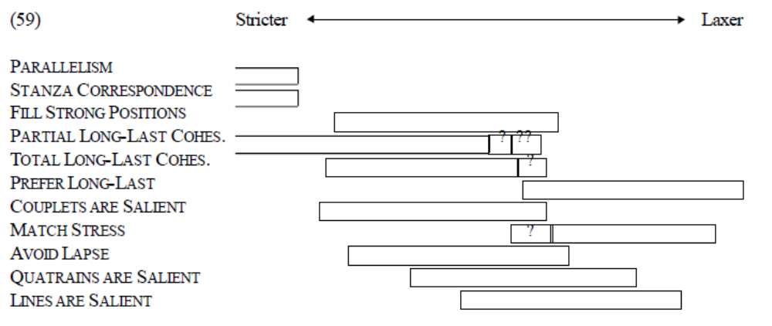
A less-restrictive theory: Stochastic OT
Early version of the idea from Hayes & MacEachern 1998.
  Each constraint is associated with a range, and those ranges also have fringes (margem), indicated by “?” or “??”
p. 43

Slide 160
Stochastic OT
Each time you want to generate an output, choose one point from each constraint’s range, then use a total ranking according to those points.
This approach defines (though without precise quantification) a probability distribution over constraint rankings.

Slide 161
Making it quantitative
Boersma 1997: the first theory to quantify ranking preference.
In the grammar, each constraint has a “ranking value”:
*θ 101
Ident(cont) 99
Every time a person speaks, they add a little noise to each of these numbers
  then rank the constraints according to the new numbers.
⇒ Go to demo [Day5_StochOT_Materials.xls]
Once again, this defines a probability distribution over constraint rankings
An Anttilan grammar is a special case of a Stochastic OT grammar

Slide 162
Boersma’s Gradual Learning Algorithm for stochastic OT
Start out with both constraints’ ranking values at 100.
You hear an adult say something—suppose /θɪk/ →[θɪk]
You use your current ranking values to produce an output. Suppose it’s /θɪk/ → [t̪ɪk].
Your grammar produced the wrong result! (If the result was right, repeat from Step 2)
Constraints that [θɪk] violates are ranked too low; constraints that [t̪ɪk] violates are too high.
So, promote and demote them, by some fixed amount (say 0.33 points)
 | /θɪk/ | *θ | Ident(cont)
the adult said this | [θɪk] | * demote to 99.67
your grammar produced this | [t̪ɪk] |  | * promote to 100.33

Slide 163
Gradual Learning Algorithm
demo (same Excel file, different worksheet)

Slide 164
Problems with the GLA for stochastic OT
Unlike with MaxEnt grammars, the space is not convex: there’s no guarantee that there isn’t a better set of ranking values far away from the current ones
And in any case, the GLA isn’t a “hill-climbing” algorithm. It doesn’t have a function it’s trying to optimize, but just a procedure for changing in response to data

Slide 165
Problems with GLA for stochastic OT
Pater 2008: constructed cases where some constraints never stop getting promoted (or demoted)
  This means the grammar isn’t even converging to a wrong solution—it’s not converging at all!
I’ve experienced this in appyling the algorithm myself

Slide 166
Still, in many cases stochastic OT works well
E.g., Boersma & Hayes 2001
  Variation in Ilokano reduplication and metathesis
  Variation in English light/dark /l/
  Variation in Finnish genitives (as we saw last time)

Slide 167
Type variation
All the theories of variation we’ve used so far predict token variation
  In this case, every theory wrongly predicts that both words vary
/mão+s/ | Ident(round) | *ãos
mãos |  | *
mães | *
/pão+s/ | Ident(round) | *ãos
pãos |  | *
pães | *

Slide 168
Indexed constraints
Pater 2009, Becker 2009
Some constraints apply only to certain words
/mão+s/_{TypeA} | Ident(round)_{TypeA} | *ãos | Ident(round)_{TypeB}
mãos |  | *
mães | *!
/pão+s/_{TypeB} | Ident(round)_{TypeA} | *ãos | Ident(round)_{TypeB}
pãos |  | *!
pães |  |  | *

Slide 169
Indexed constraints
If the grammar is itself variable, we can have some words whose behavior is variable (Huback 2011 example)
/sidadão+s/_{TypeC} | Ident(round)_{TypeC} weight: 100 | *ãos weight: 98
sidadãos |  | *
sidadães | *

Slide 170
Where to go from here: R and regression
Download R
  www.r-project.org
Download Harald Baayen’s book Analyzing Linguistic Data: A Practical INtroduction to Statistics using R
  www.ualberta.ca/~baayen/publications/baayenCUPstats.pdf
Work through the analyses in the book
  Baayen gives all the R commands and lets you download the data sets, so you can do the analyses in the book as you read about them

Slide 171
Where to go: Optimality Theory
Read John McCarthy’s book Doing Optimality Theory: Applying Theory to Data
  A practical guide for actually doing OT
If you enjoy that, read John McCarthy’s book Optimality Theory: A Thematic Guide
  Goes into more theoretical depth
There is a book in Portuguese, João Costa’s 2001 Gramática, conflitos e violações. Introdução à Teoria da Optimidade
Download OTSoft
  www.linguistics.ucla.edu/people/hayes/otsoft
  If you give it the candidates, constraints, and violations, it will tell you the ranking

Slide 172
Where to go: Stochastic OT and Gradual Learning Algorithm
Read Boersma & Hayes’s 2001 article “Empirical tests of the Gradual Learning Algorithm”
Download the data sets for the article and play with them in OTSoft
  www.fon.hum.uva.nl/paul/gla, under part 3
  Try different GLA options
  Try learning algorithms other than GLA

Slide 173
Where to go: Harmonic Grammar and Noisy HG
Unfortunately, I don’t know of any friendly introductions to these
Download OT-Help and try the examples
  people.umass.edu/othelp/
  The OT-Help manual might be the easiest-to-read summary of Harmonic Grammar that exists!
  Try the sample files

Slide 174
Where to go: MaxEnt
The original proposal to use MaxEnt for phonology was Goldwater & Johnson 2003, but it’s difficult to read
Andy Martin’s 2007 UCLA dissertation has an easier-to-read introduction (chapter 4)
  www.linguistics.ucla.edu/general/Dissertations/Martin_dissertationUCLA2007.pdf
You could try using OTSoft to fit a MaxEnt model to the Boersma/Hayes data

Slide 175
Where to go: MaxEnt’s Gaussian prior
To use the prior (bias against changing weights from default), download the MaxEnt Grammar Tool
  www.linguistics.ucla.edu/people/hayes/MaxentGrammarTool
  In addition to the usual OTSoft input file, you need to make a file with mu and sigma² for each constraint (there is a sample file)
Good examples to read of using the prior
  Chapter 4 of Andy Martin’s dissertation
  White & Hayes 2013 article, “Phonological naturalness and phonotactic learning” /www.linguistics.ucla.edu/people/grads/jwhite/documents/HayesWhitePhonologicalNaturalnessAndPhonotacticLearning.pdf

Slide 176
Where to go: lexical variation
Becker’s 2009 UMass dissertation, “Phonological Trends in the Lexicon: The Role of Constraints”, develops the lexical-indexing approach
  www.phonologist.org/papers/becker_dissertation.pdf
Hayes & Londe’s 2006 paper “Stochastic phonological knowledge: the case of Hungarian vowel harmony” uses another approach (Zuraw’s UseListed)
  www.linguistics.ucla.edu/people/hayes/HungarianVH

Slide 177
Thanks for attending!
Stay in touch: kie@ucla.edu
Working on a phonology project (with or without variation)? I’d be interested to read it.

Slide 178
Day 5 references
Becker, M. (2009). Phonological trends in the lexicon: the role of constraints (Ph.D. dissertation). University of Massachusetts Amherst.
Boersma, P. (1997). How we learn variation, optionality, and probability. Proceedings of the Institute of Phonetic Sciences of the University of Amsterdam, 21, 43–58.
Boersma, P., & Hayes, B. (2001). Empirical tests of the gradual learning algorithm. Linguistic Inquiry, 32, 45–86.
Goldwater, S., & Johnson, M. (2003). Learning OT Constraint Rankings Using a Maximum Entropy Model. In J. Spenader, A. Eriksson, & Ö. Dahl (Eds.), Proceedings of the Stockholm Workshop on Variation within Optimality Theory (pp. 111–120). Stockholm: Stockholm University.
Hayes, B., & Londe, Z. C. (2006). Stochastic Phonological Knowledge: The Case of Hungarian Vowel Harmony. Phonology, 23(01), 59–104. doi:10.1017/S0952675706000765

Slide 179
Day 5 references
Hayes, B., & MacEachern, M. (1998). Quatrain form in English folk verse. Language, 64, 473–507.
Hayes, B., & White, J. (2013). Phonological Naturalness and Phonotactic Learning. Linguistic Inquiry, 44(1), 45–75. doi:10.1162/LING_a_00119
Huback, A. P. (2011). Irregular plurals in Brazilian Portuguese: An exemplar model approach. Language Variation and Change, 23(02), 245–256. doi:10.1017/S0954394511000068
Martin, A. (2007). The evolving lexicon (Ph.D. Dissertation). University of California, Los Angeles.
Pater, J. (2008). Gradual Learning and Convergence. Linguistic Inquiry.
Pater, J. (2009). Morpheme-specific phonology: constraint indexation and inconsistency resolution. In S. Parker (Ed.), Phonological argumentation: essays on evidence and motivation. Equinox.
Yang, C. (2010). Three factors in language variation. Lingua, 120(5), 1160–1177. doi:10.1016/j.lingua.2008.09.015

